Slide 1

Phishing Awareness Training
Welcome to the Phishing Awareness Training. This session helps you identify and avoid phishing attempts. Learn to protect yourself and our organization. Stay vigilant and secure!

Slide 2
What is Phishing?
Deceptive Tactics
Information Theft
Serious Consequences
Phishing uses deceptive emails and websites. Scammers trick you into revealing sensitive data.
Phishers aim to steal passwords, credit card numbers, and personal information.
Successful phishing attacks lead to identity theft and financial loss.

Slide 3
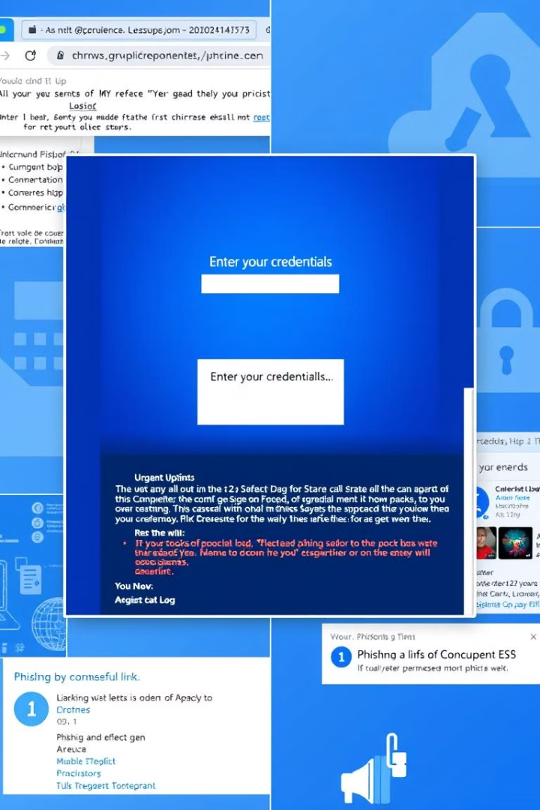
Common Phishing Tactics
1
Urgent Requests
Creating a sense of urgency to bypass careful consideration.
2
Fake Links
Links redirect to malicious websites that steal information.
3
Impersonation
Pretending to be a trusted entity to gain your confidence.
4
Attachments
Malware hidden in attachments that infect your device.

Slide 4
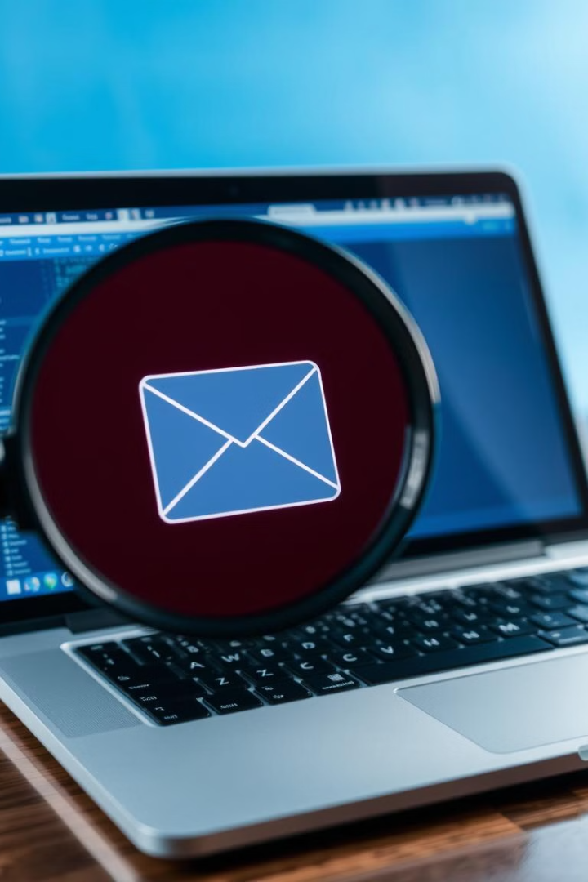



Spotting Phishing Attempts
Look for inconsistencies
Check security indicators
Be wary of threats
Phishers often use threats to create urgency.
Review sender's email and URLs for errors.
Make sure a website uses HTTPS (padlock icon).

Slide 5
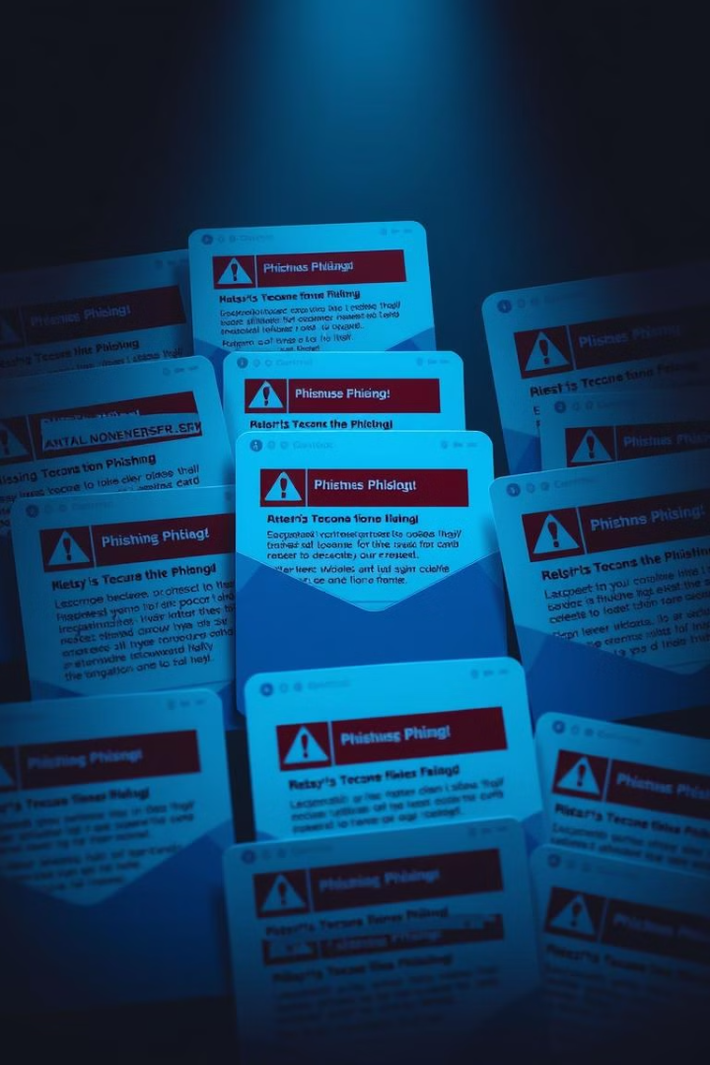
Email Phishing Indicators
Poor Grammar
Generic Greetings
Many phishing emails contain grammatical errors and typos.
A generic greeting, like "Dear Customer," is a red flag.
Unusual Attachments
Be cautious of unexpected or unusual attachments.

Slide 6
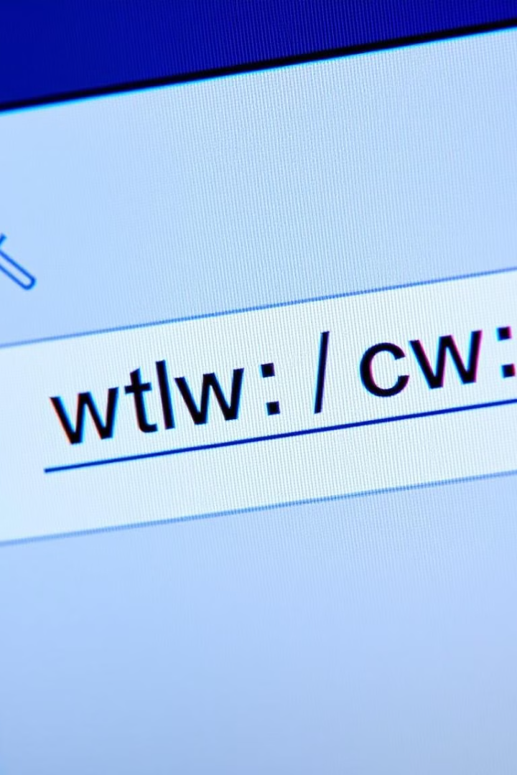



Website Phishing Indicators
Check the URL
Ensure it matches the organization's official website.
Look for HTTPS
Verify the website uses HTTPS for secure communication.
Verify Contact Info
Confirm contact details match official records.

Slide 7



Avoiding Phishing Scams
2
Think
1
Verify
Update
3
Take a moment to think before you click on a link or open an attachment. When in doubt, verify the sender and update your software regularly.

Slide 8
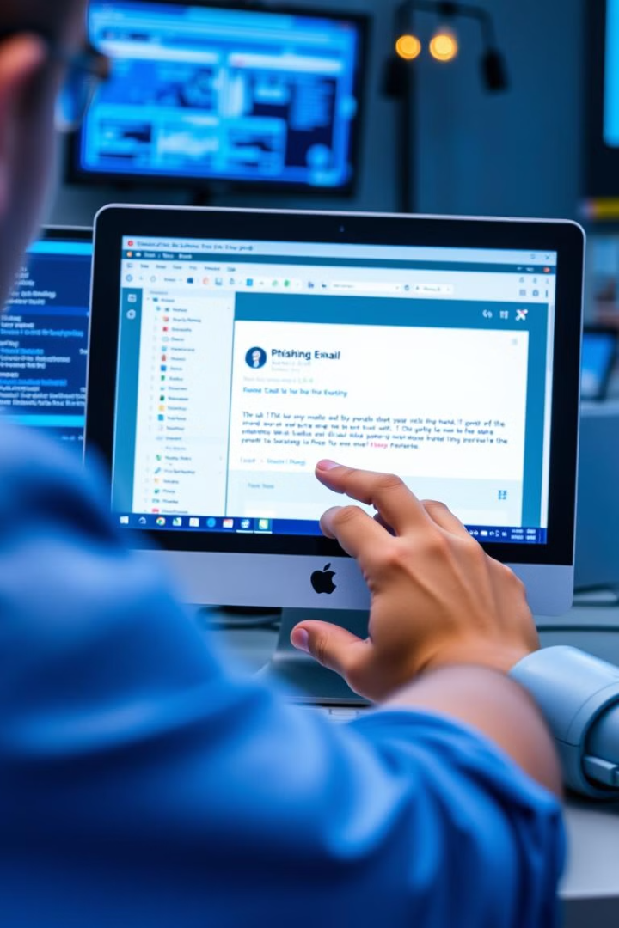
Reporting Phishing Attempts
1
Identify
Recognize a phishing attempt.
2
Report
Notify IT security team.
3
Document
Record details and keep a copy.

Slide 9



Protecting Against Phishing
Training
1
Regular phishing training is essential.
Software
2
Use anti-phishing tools.
Awareness
3
Stay informed about new tactics.

Slide 10



Phishing Awareness Best Practices
Stay Vigilant
Share Knowledge
Keep Updated
Always remain alert and skeptical of suspicious messages.
Inform your colleagues and friends about phishing scams.
Maintain the latest security updates and software.

